Slide 1
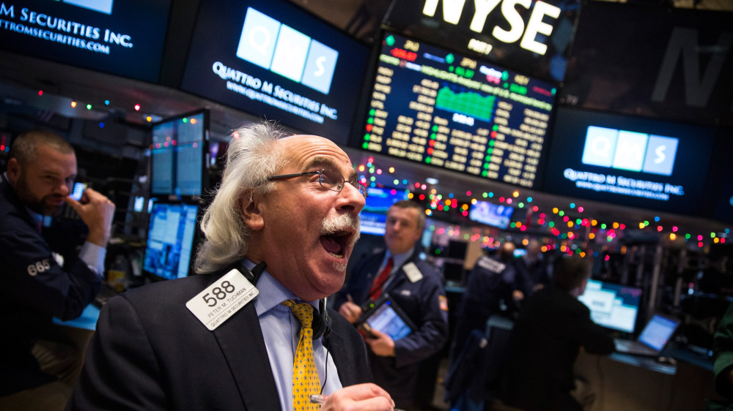
Win the stock market by Lucas HOssi

Slide 2
Motivations:
Stock exchange is becoming a very common thing to even just regular people.
More often than not, people just end up losing money to it, But it doesn’t have to be this way anymore.
We can use linear algebra to model and predict the trends in stock over time, we can use different methods to find the best fit to our data or stock trend and predict what the future changes may be in a more accurate way as the trend of stocks uses some computer modelling and with some luck we can reproduce it.

Slide 3
Model/Computing Method & Python Tools:
Data Modeling
Apply a fit using different methods
Finally, choose what algorithm performs the best fit and see the prediction
I Intend to use make usage of any python tools I can use

Slide 4
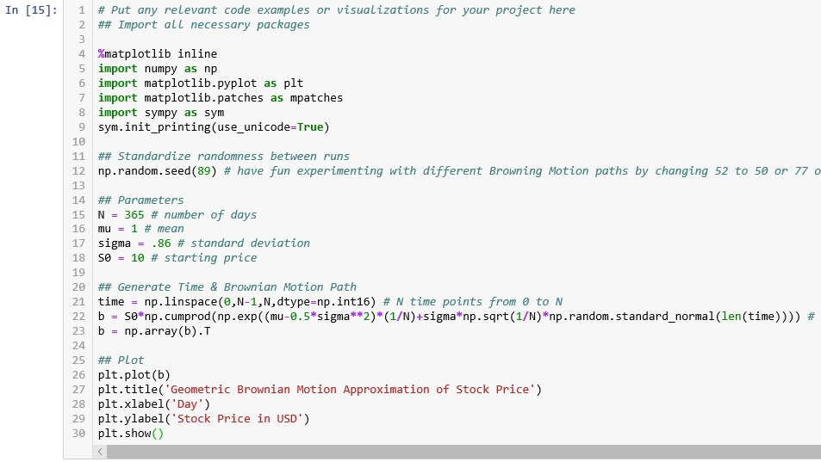

Slide 5
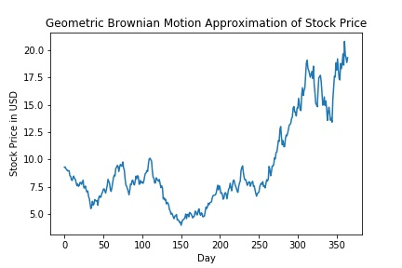

Slide 6
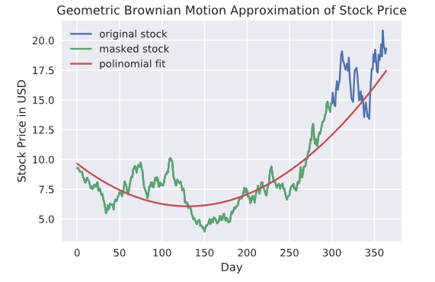

Slide 7
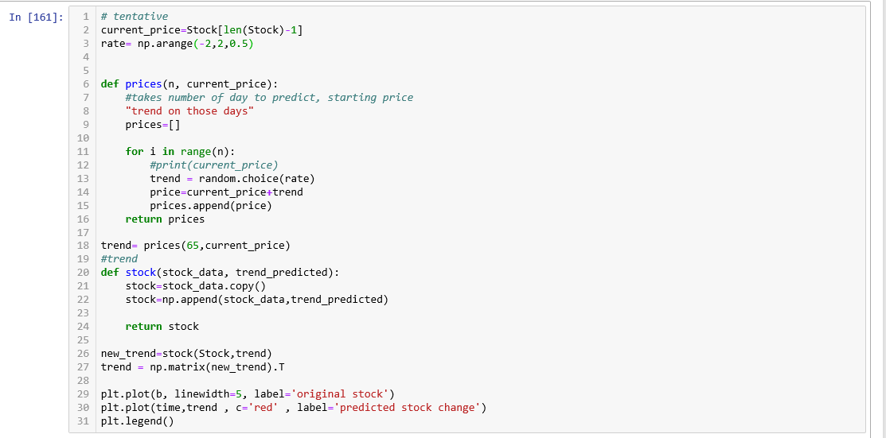

Slide 8
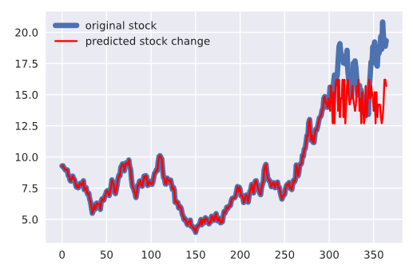

Slide 9
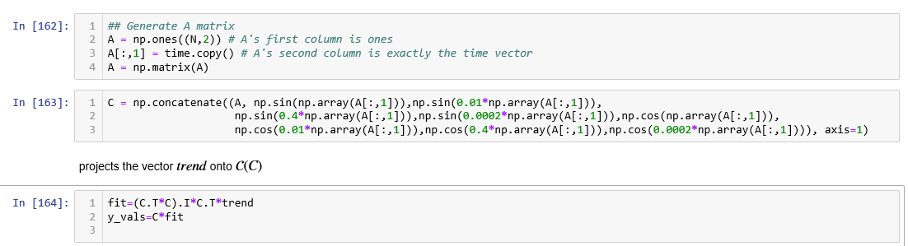

Slide 10
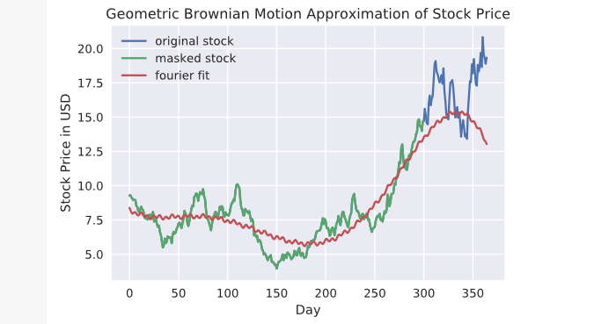

Slide 11
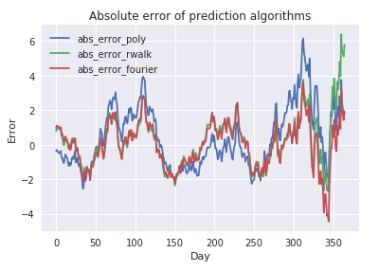
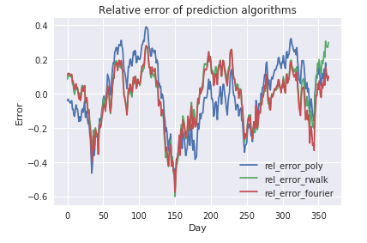
Remarks
Looking at the graphs for the relative error and absolute error we can clearly see that the Fourier algorithm has the smallest absolute and relative error compared to the other algorithms. This outcome was to be expected as the Brownian motion is a period function and Fourier series is the best approximation we can find out of the tested algorithms

Slide 12
Conclusion & Future Work
I believe things went pretty well on this project, but there is always room for improvement. Some other things to improve on this project is the prediction algorithm where we could possibly use some machine learning because the usage of random numbers by itself is not producing very satisfactory results

Slide 13
References
Dirk Colbry
http://1.bp.blogspot.com/-b0blf46njtE/UJqHdwPndbI/AAAAAAAABxE/2LAB0P5kdxw/s1600/Monte+Carlo+Part+3.gif
https://www.investopedia.com/terms/m/montecarlosimulation.asp

